Slide 1



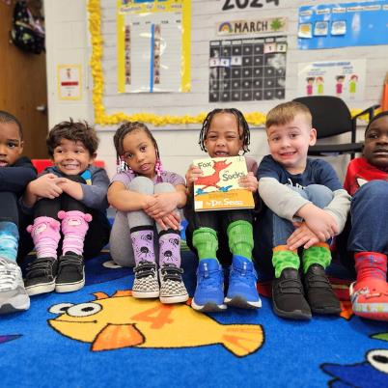
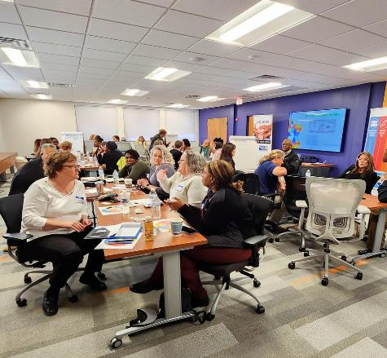

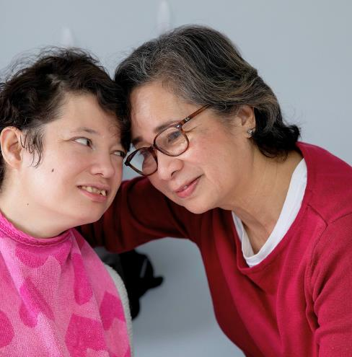
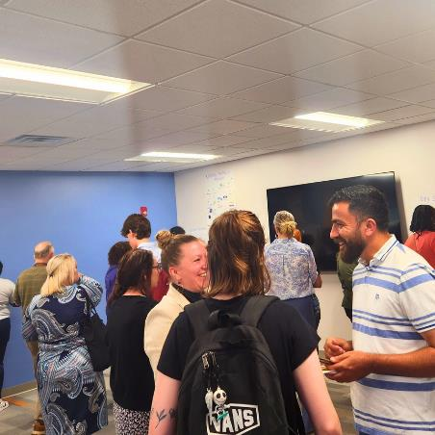
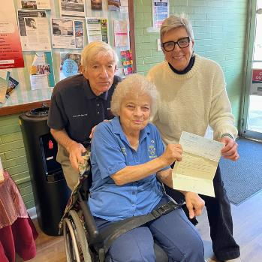

WELCOME!
CONNECTING OUR COMMUNITY TO HELP AND HOPE
Notes:
Sponsored by HII, NNS

Slide 2



Who is ALICE?
Asset Limited, Income Constrained, Employed

Slide 3
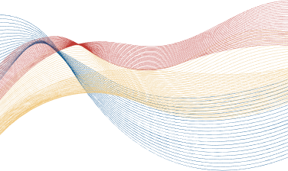
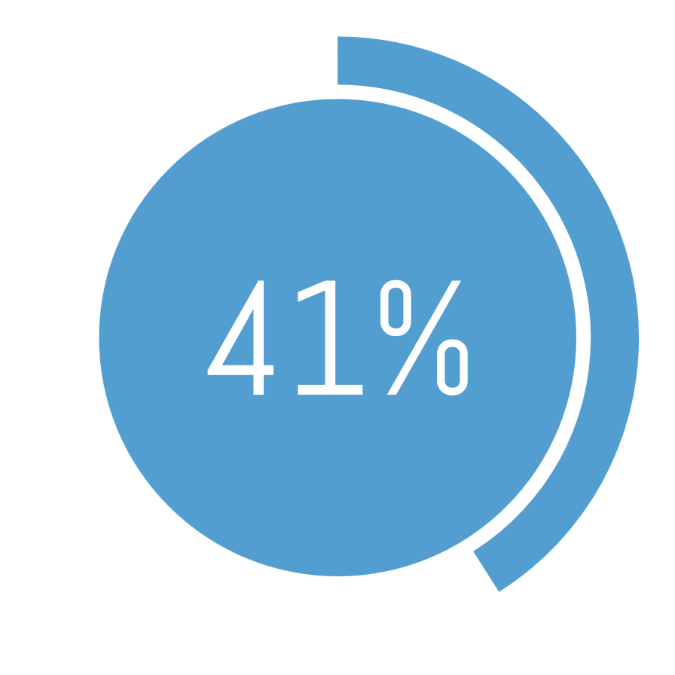

ALICE in Our Community
of households on the
VA Peninsula are experiencing poverty
or are ALICE.

Slide 4








2024/25 Community Goal:
“CONNECTIONS START HERE”
One Phone Number
Access to 150+ Partners
9,735
Individuals Assisted
$5.6 million mobilized
July 2021-June 2024
Every person in our community, whether they have a need or something to give, can get connected through United Way.
JOIN US IN CONNECTING OUR COMMUNITY TO HELP AND HOPE
Notes:
Note for verbal presentation:
When we look at connections this way, basically every connection to give gets multiplied more than 20 times to help someone in need.
Approx. 5% increase in connections- more than last year

Slide 5
Peninsula Eviction Reduction Pilot
Multi-sector funding:
Department of Housing & Community Development
Bernardine Franciscan Sisters Foundation
Blocker Foundation
Faith Community
Corporate Partner
Eviction Court Navigation in 5 Courts
Impactful Partnerships:
Sub-granted Nonprofit and Human Services Organizations
Direct Service and Supportive Service Agreements
Centralized Resources with No Wrong Door
Convening and Advocacy Efforts

Slide 6







Community Measures Of Success
23% Decrease in Unlawful Detainers
56% Decrease in Executed Evictions
Notes:
Give Time, add Sponsored by ReMax Connect and Spain Commercial

Slide 7
York-Poquoson
Highest Housing Stability Rate on the Peninsula
Notes:
Give Time, add Sponsored by ReMax Connect and Spain Commercial

Slide 8
THREATS & CHALLENGES:
Alternatives to traditional leasing
OPPORTUNITIES AHEAD:
Extended Hours
Post-Eviction Supports
System Adjustments for sustainable household impact
Where Else Can We Apply This Model To Help Your Constituents?

Slide 9

Youth Employment Pilot
A Partnership with Busch Gardens Williamsburg and the Hampton Roads Workforce Council
Youth and young adults 16-24 years old
Specialized recruiting and hiring
Transportation Provided
Valuable work experience and training
Fall/Winter 2023, 43 Hired Participants
Spring 2024, 29 Hired Participants
Fall/Winter 2024, 58 Hired Participants
Every Day Strong, Building Youth Resilience
Community Mentorship Initiative

Slide 10
United is the Way to Community Resilience
Emergency Communications
Financial and
In-Kind Donation Collection and Distribution
Volunteer Recruitment and Management Assistance

